Slide 1
End Times
Exile to Babylon
State of Israel
2nd coming
of Jesus
Israel attacked
1000 year
Millennial reign
586 BC
Tribulation
Last days
Rev 6-16
Rev 19
Rev 20
Eze 36-37
Eze 38-39
Eze 40-48
Dan 9

Slide 2
End Times: The great battle against Israel
Ezekiel 38:
¹ The word of the Lord came to me: ² ‘Son of man, set your face against Gog, of the land of Magog, the chief prince of Meshek and Tubal; prophesy against him ³ and say: “This is what the Sovereign Lord says: I am against you, Gog, chief prince of Meshek and Tubal. ⁴ I will turn you around, put hooks in your jaws and bring you out with your whole army – your horses, your horsemen fully armed, and a great horde with large and small shields, all of them brandishing their swords. ⁵ Persia, Cush and Put will be with them, all with shields and helmets, ⁶ also Gomer with all its troops, and Beth Togarmah from the far north with all its troops – the many nations with you.

Slide 3
End Times: The great battle against Israel
Ezekiel 38:
¹⁰ ‘“This is what the Sovereign Lord says: on that day thoughts will come into your mind and you will devise an evil scheme. ¹¹ You will say, ‘I will invade a land of unwalled villages; I will attack a peaceful and unsuspecting people – all of them living without walls and without gates and bars. ¹² I will plunder and loot and turn my hand against the resettled ruins and the people gathered from the nations, rich in livestock and goods, living at the centre of the land.’ ¹³ Sheba and Dedan and the merchants of Tarshish and all her villages will say to you, ‘Have you come to plunder? Have you gathered your hordes to loot, to carry off silver and gold, to take away livestock and goods and to seize much plunder?’”

Slide 4
End Times: The great battle against Israel
Ezekiel 38:
¹⁸ This is what will happen in that day: when Gog attacks the land of Israel, my hot anger will be aroused, declares the Sovereign Lord. ¹⁹ In my zeal & fiery wrath I declare that at that time there shall be a great earthquake in the land of Israel. ²⁰ The fish in the sea, the birds in the sky, the beasts of the field, every creature that moves along the ground, and all the people on the face of the earth will tremble at my presence. The mountains will be overturned, the cliffs will crumble and every wall will fall to the ground. ²¹ I will summon a sword against Gog on all my mountains, declares the Sovereign Lord. Every man’s sword will be against his brother. ²² I will execute judgment on him with plague and bloodshed; I will pour down torrents of rain, hailstones and burning sulphur on him and on his troops and on the many nations with him. ²³ And so I will show my greatness and my holiness, and I will make myself known in the sight of many nations. Then they will know that I am the Lord.”

Slide 5
End Times: The great battle against Israel
Genesis 10:2-4
² The sons of Japheth: Gomer, Magog, Madai, Javan, Tubal, Meshek and Tiras.
³ The sons of Gomer: Ashkenaz, Riphath and Togarmah.
⁴ The sons of Javan: Elishah, Tarshish, the Kittites and the Rodanites.

Slide 6
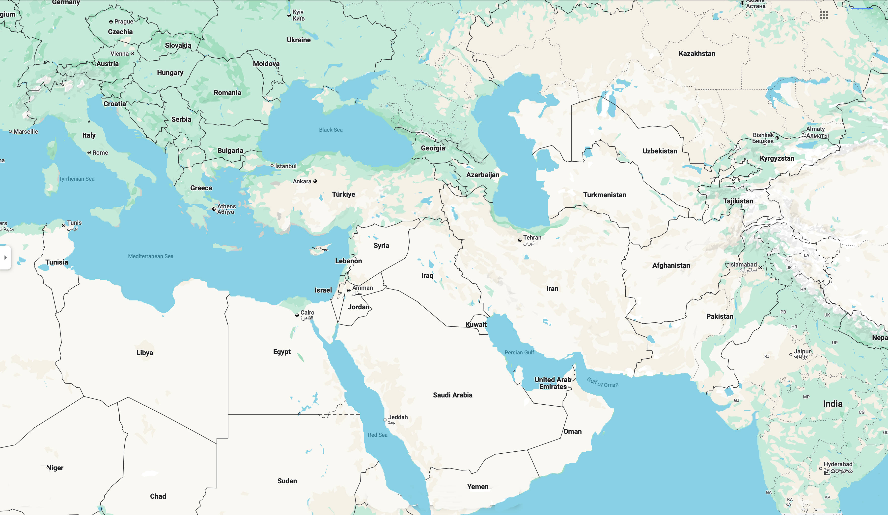
Magog
Scythians

Slide 7
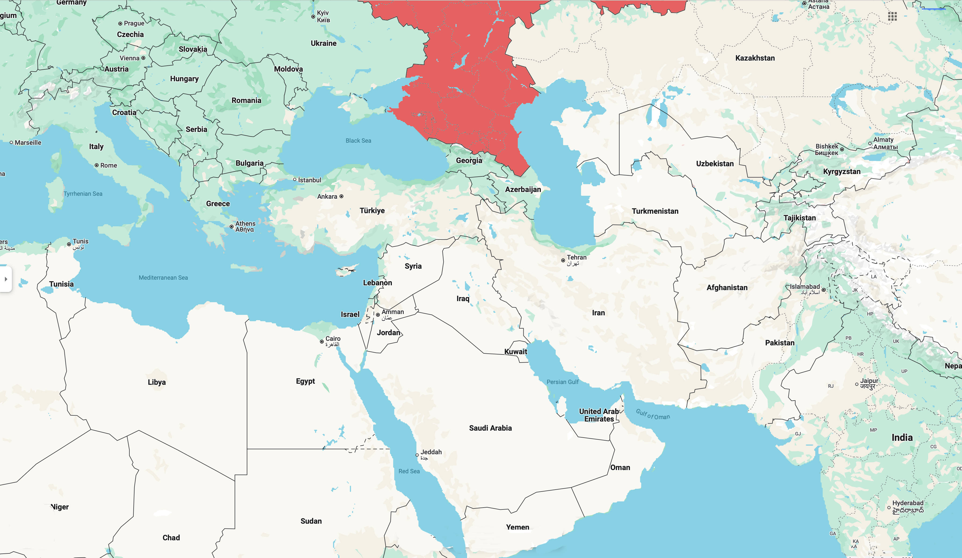
Magog
Scythians

Slide 8
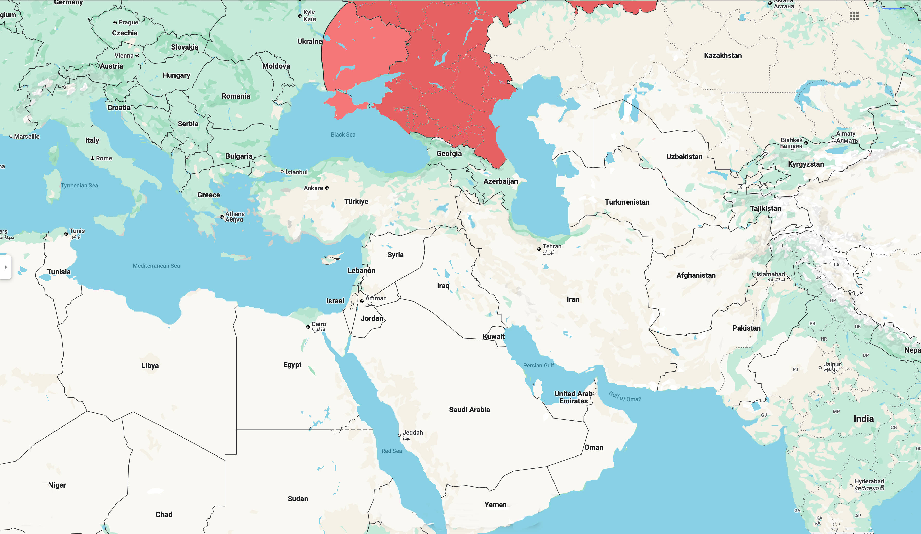
Magog
Scythians

Slide 9
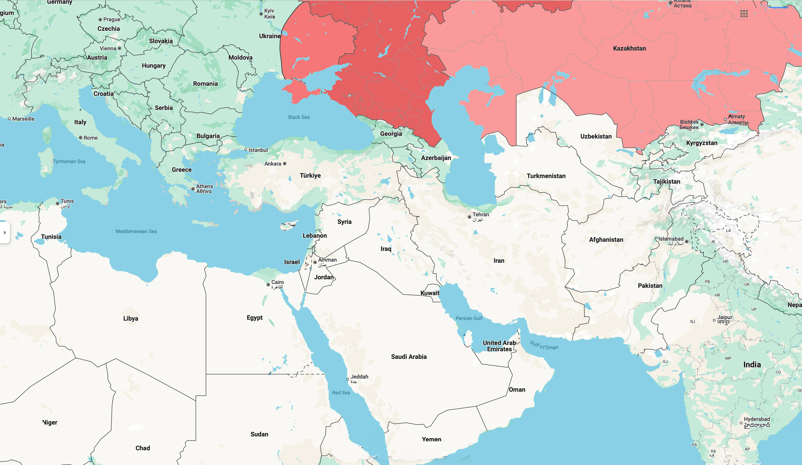
Magog
Scythians

Slide 10
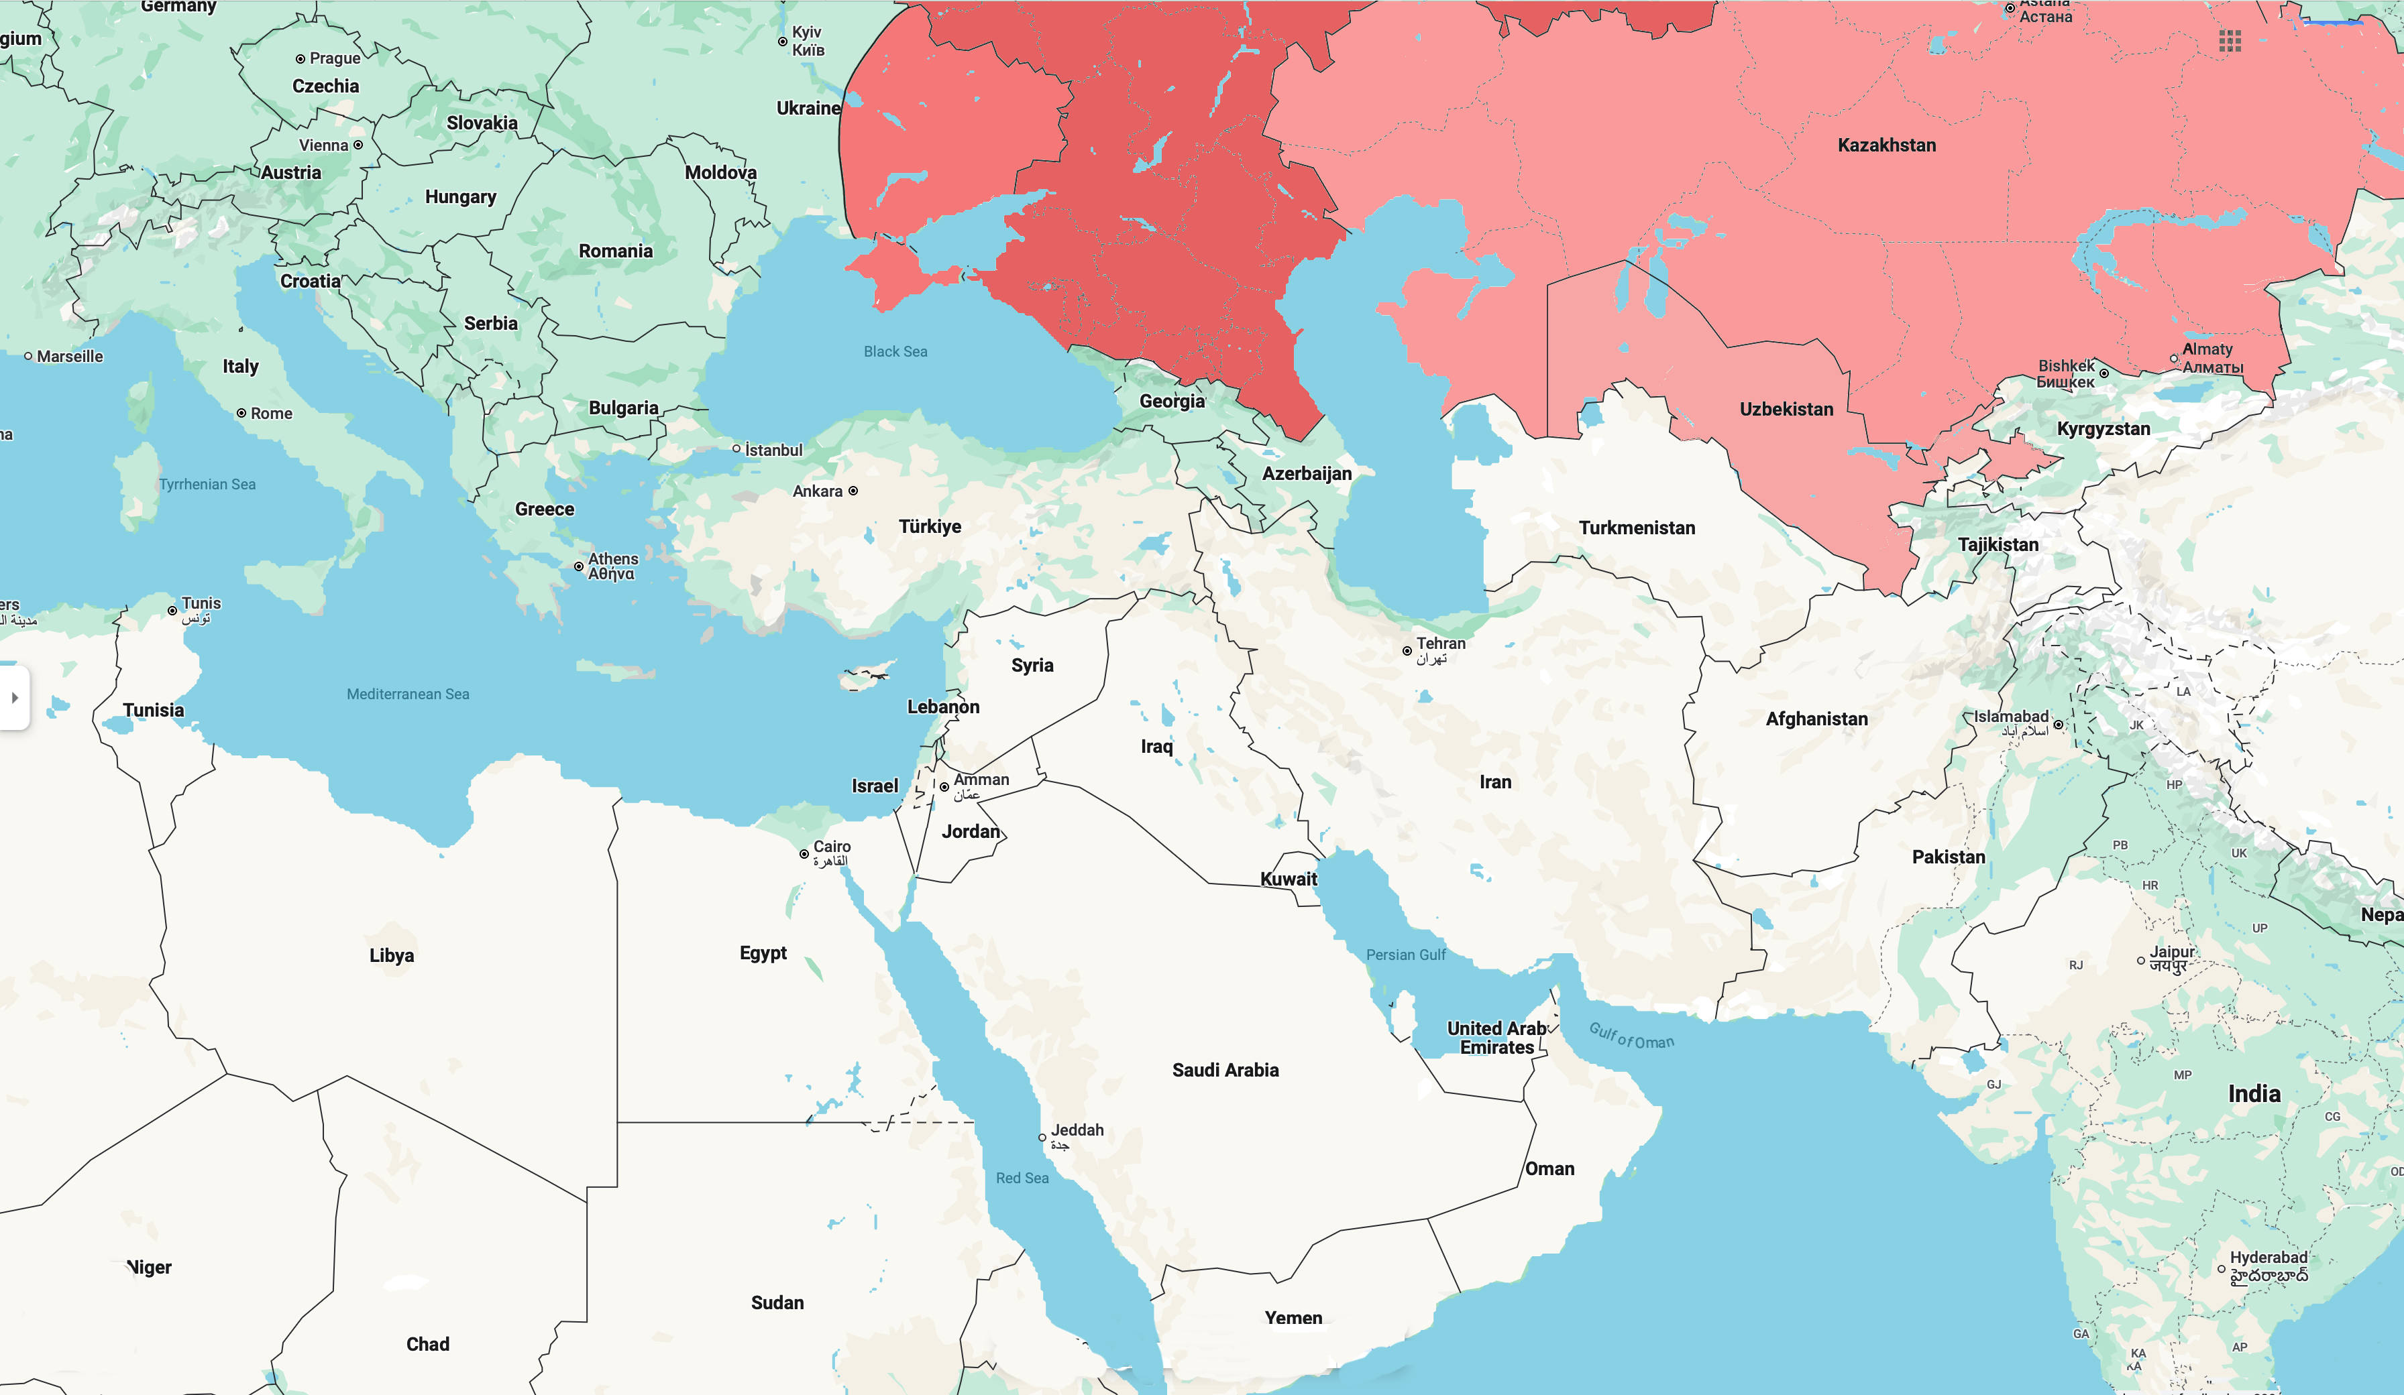
Magog
Scythians

Slide 11
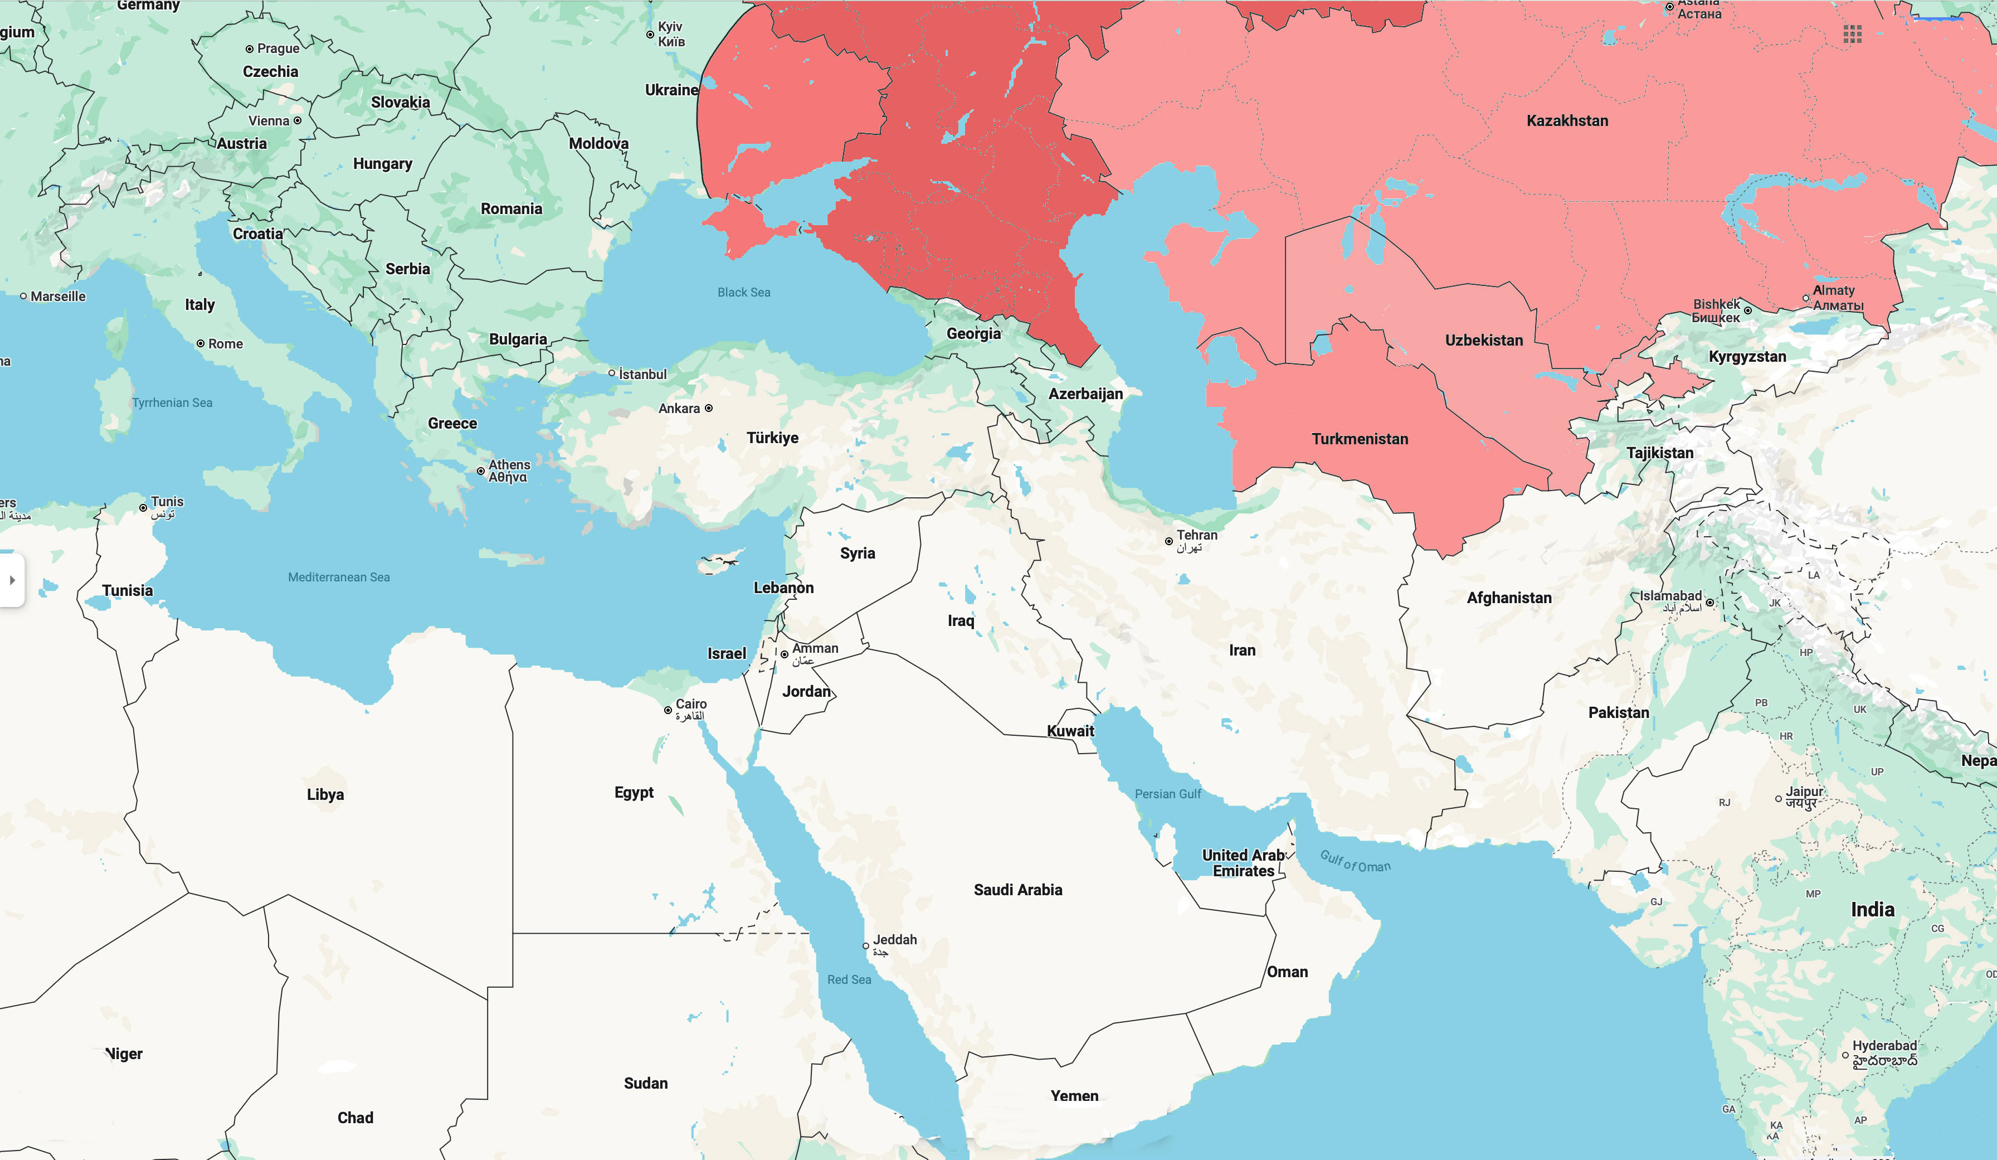
Magog
Scythians

Slide 12
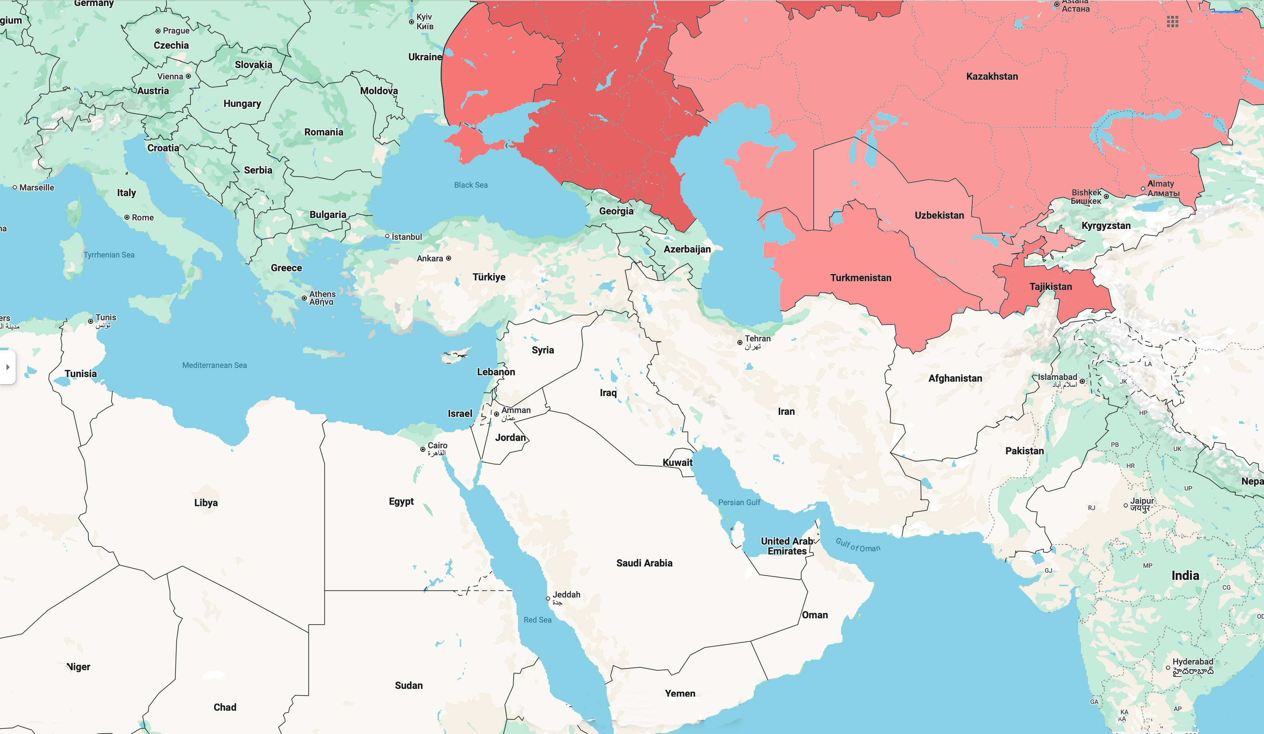
Magog
Scythians

Slide 13
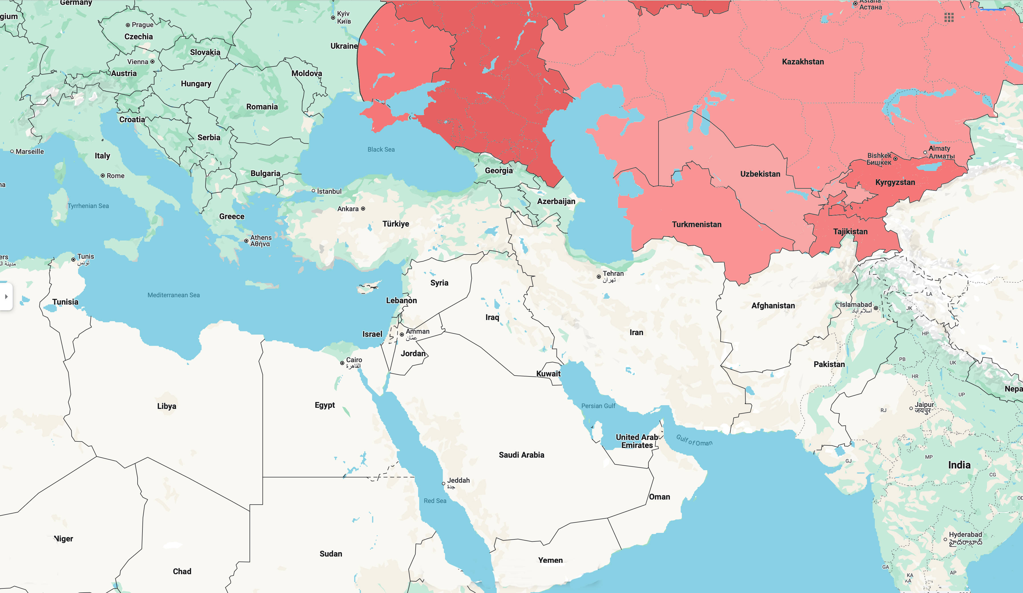
Magog
Scythians

Slide 14
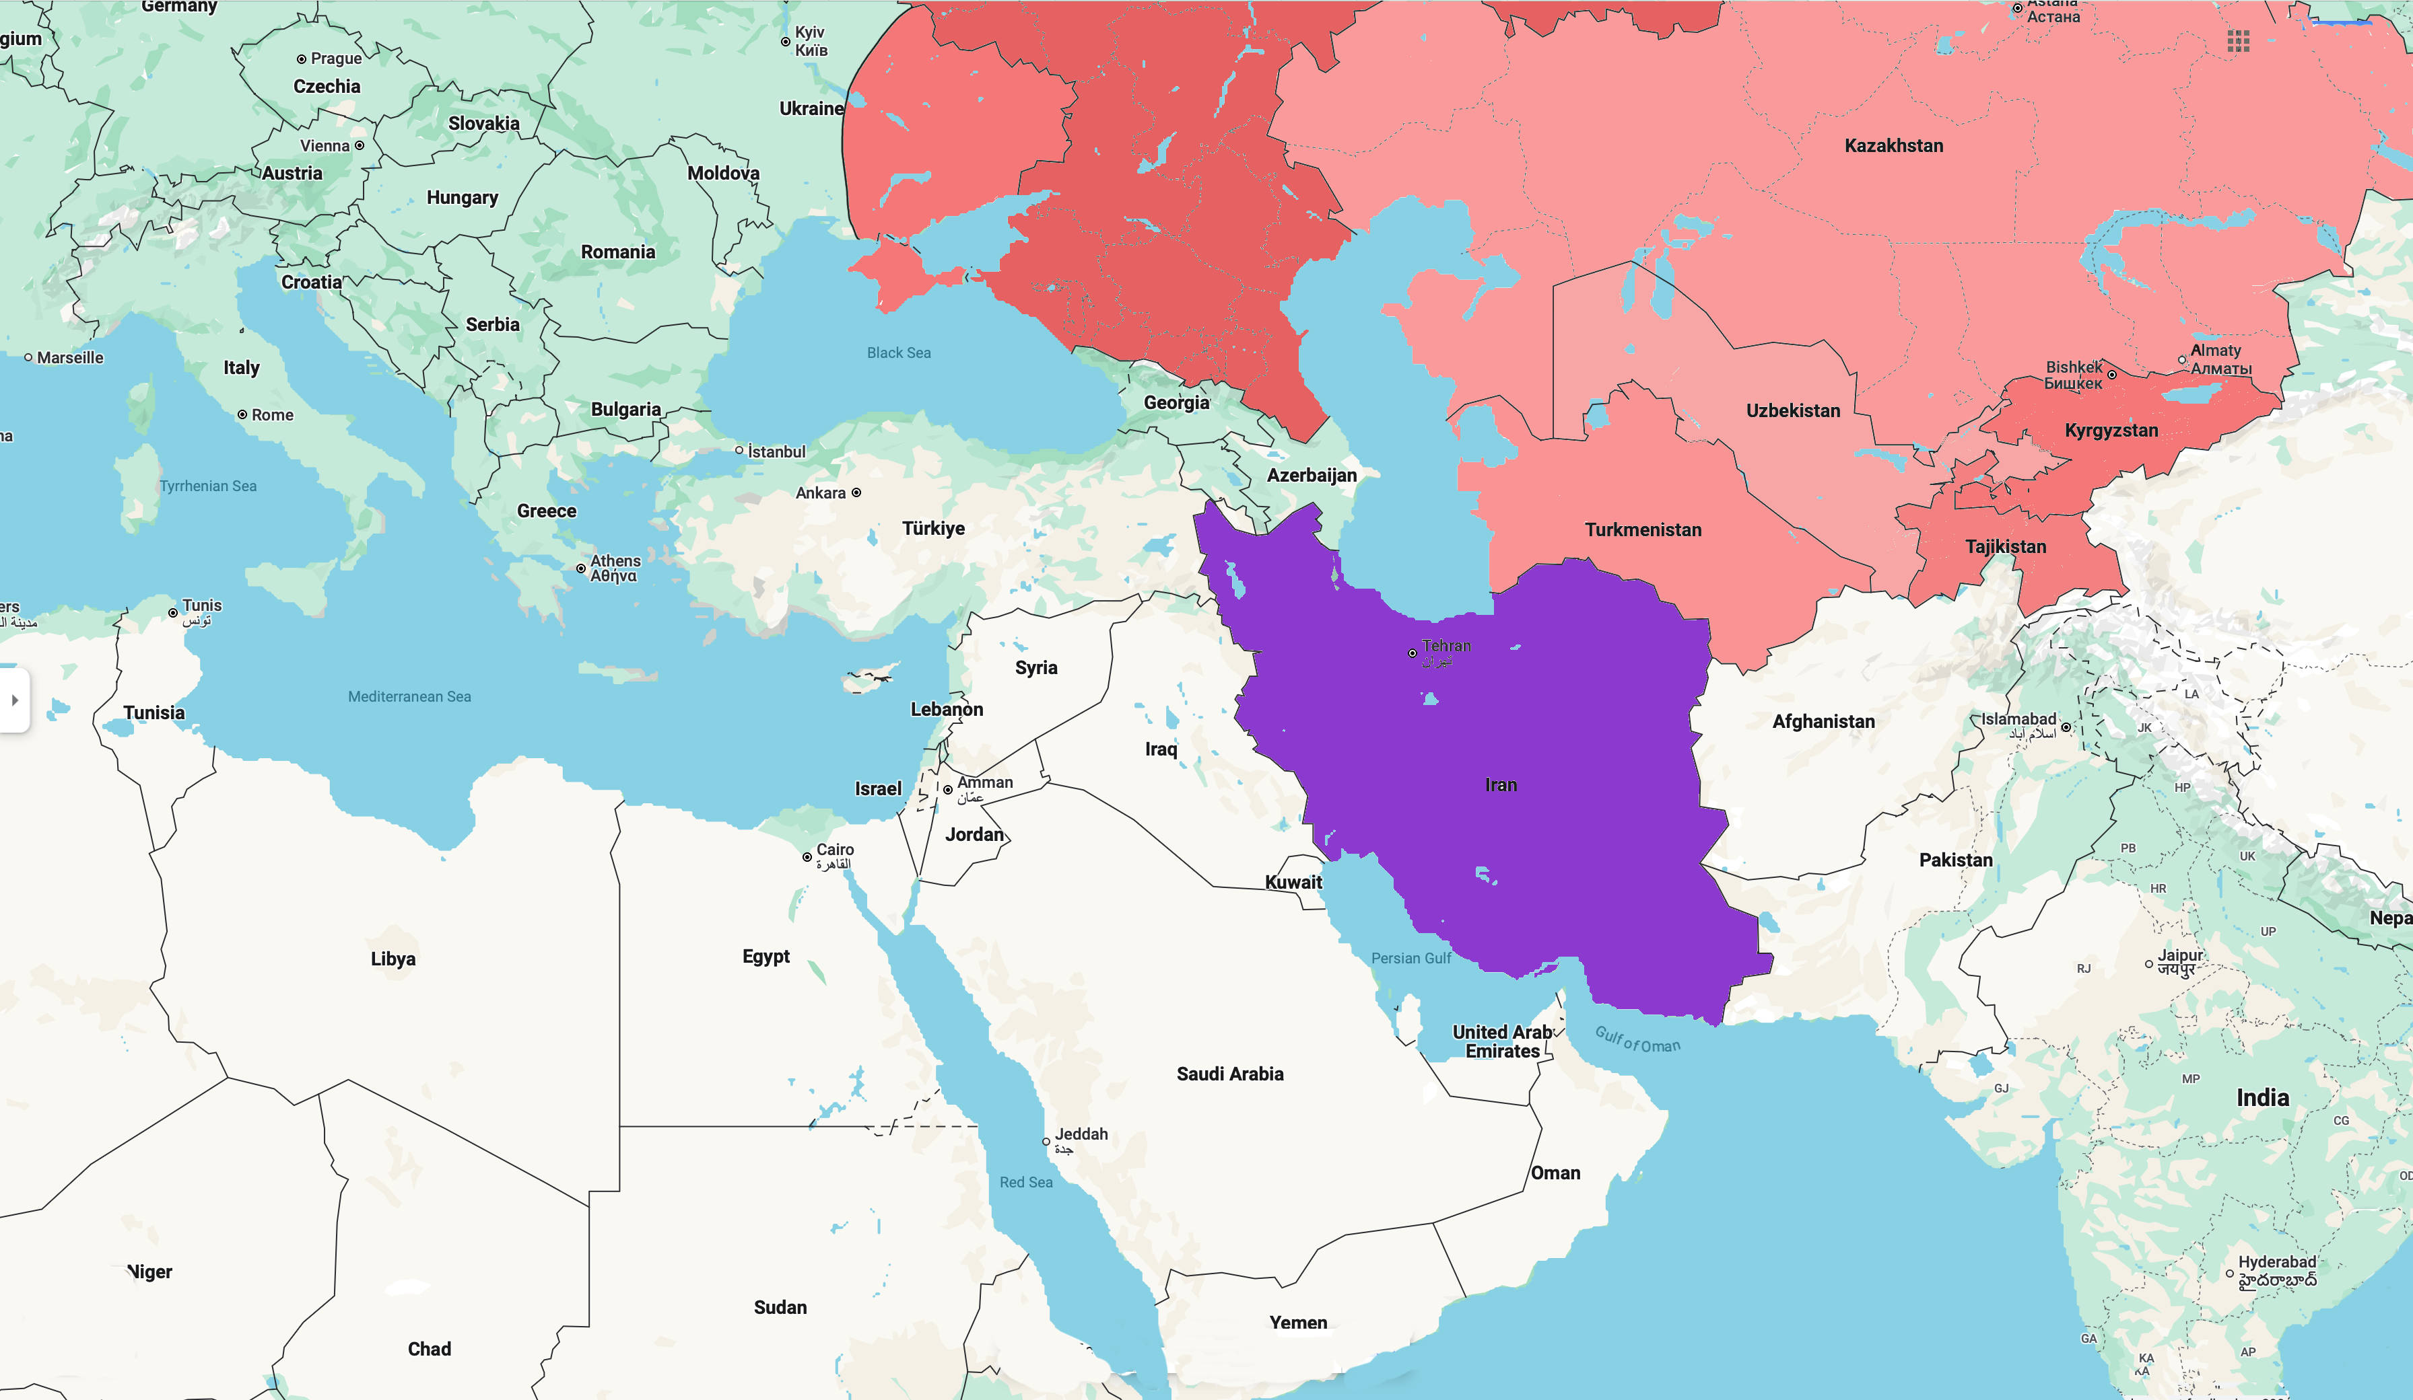
Magog Persia

Slide 15
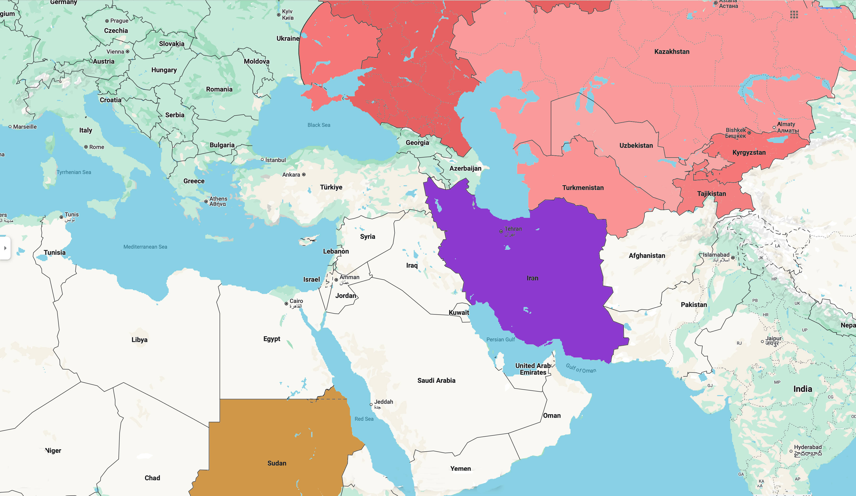
Magog Persia Cush

Slide 16
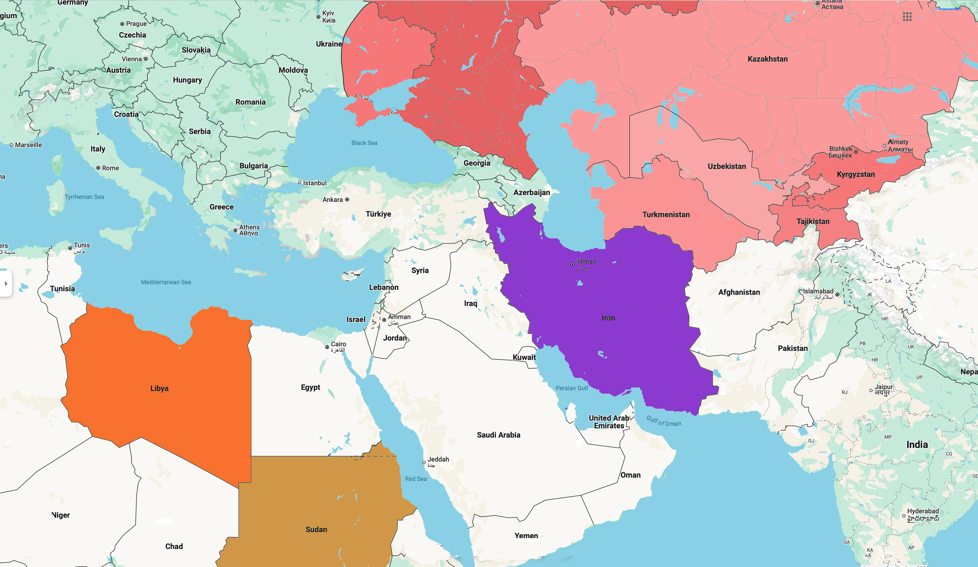
Magog Persia Cush Put

Slide 17
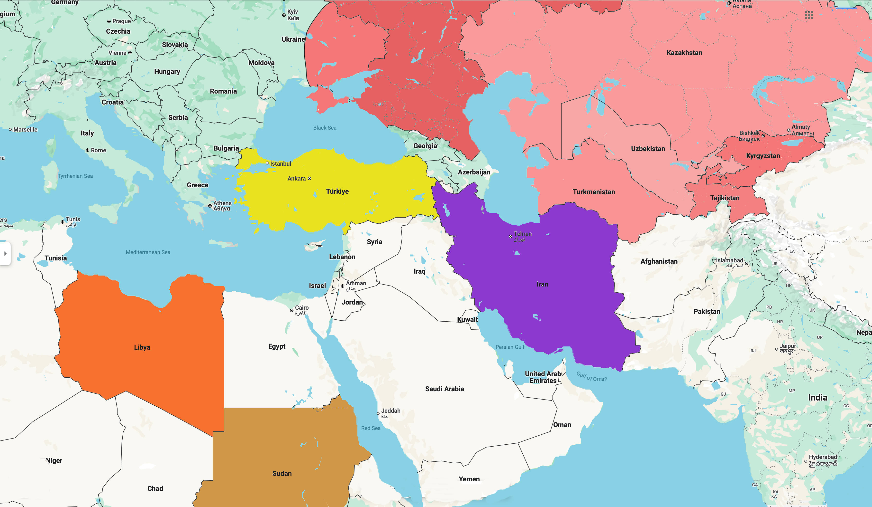
Magog Persia Cush Put Gomer

Slide 18
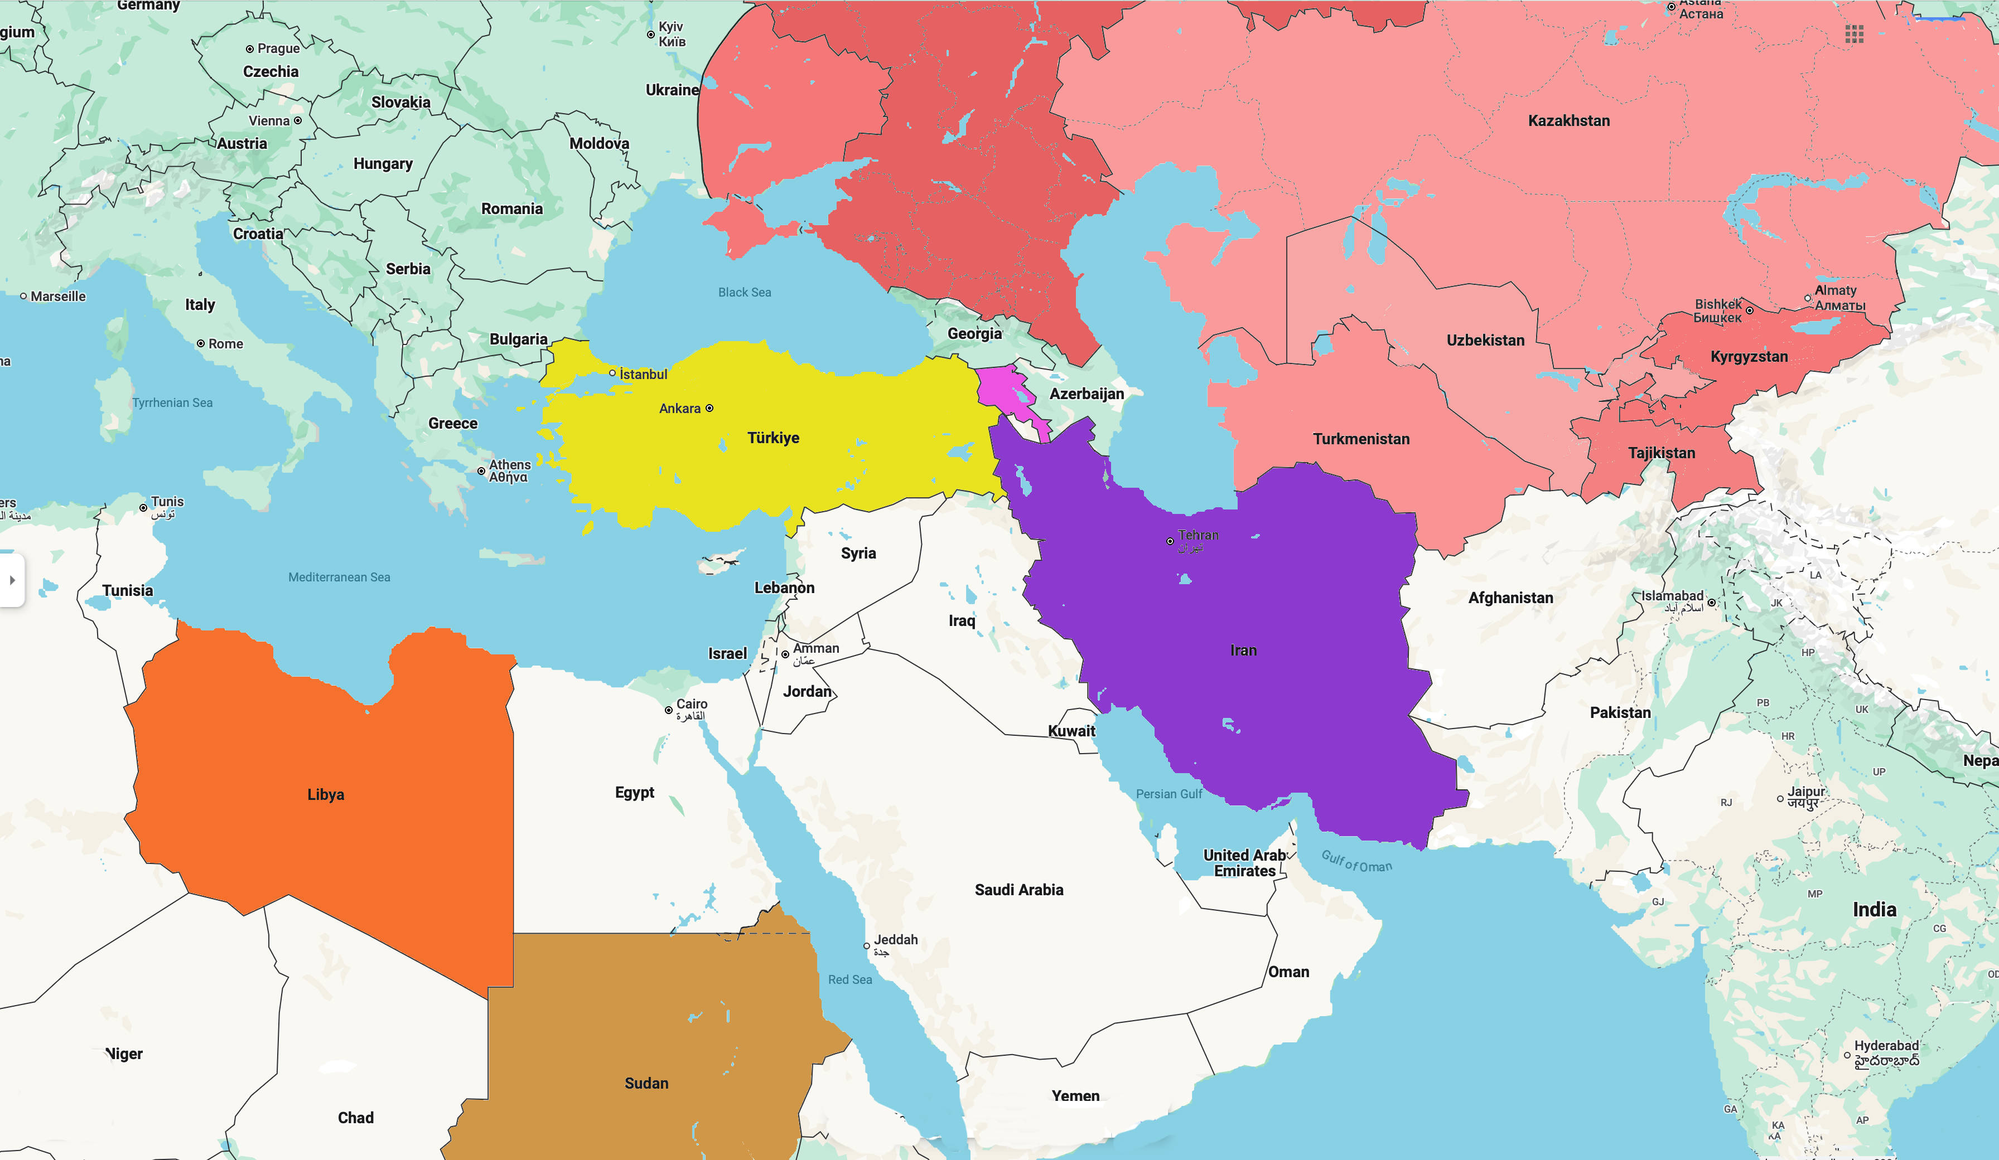
Magog Persia Cush Put Gomer Togarmah

Slide 19
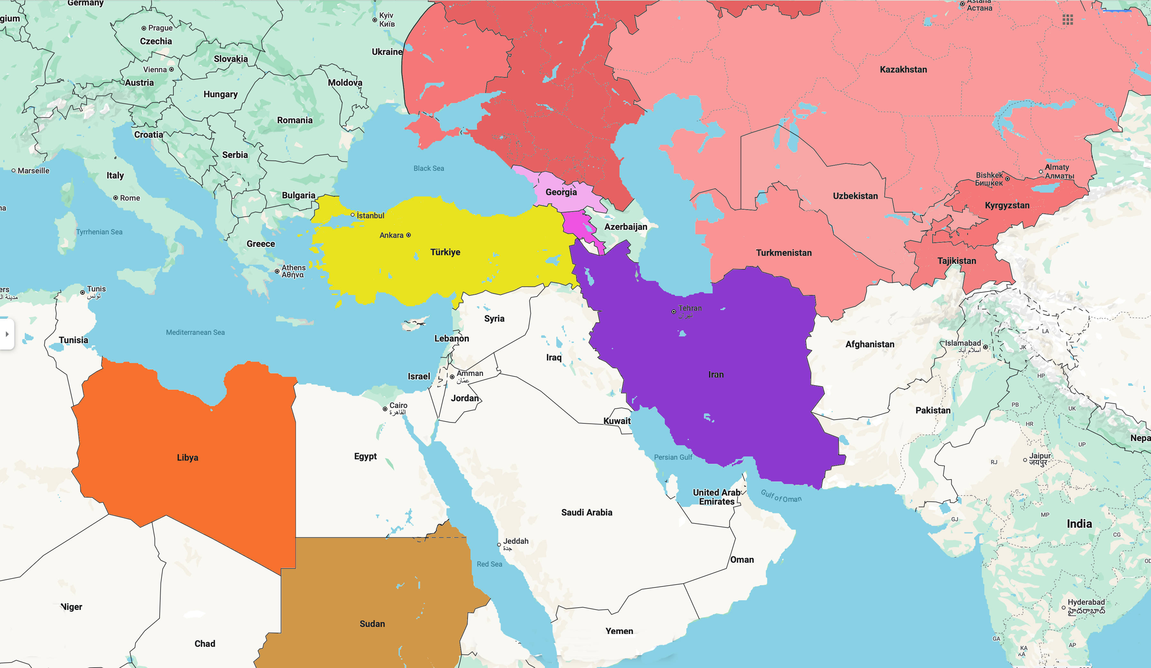
Magog Persia Cush Put Gomer Togarmah

Slide 20

Magog Persia Cush Put Gomer Togarmah

Slide 21
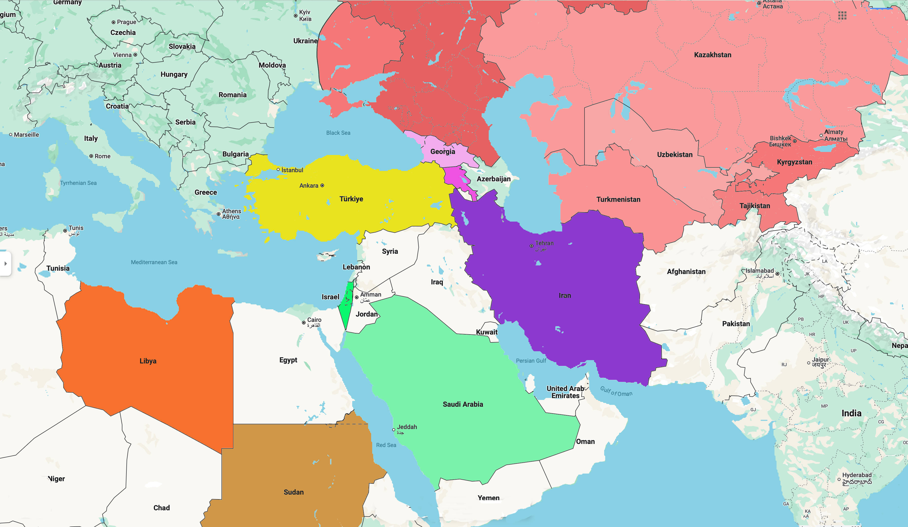
Magog Persia Cush Put Gomer Togarmah Sheba & Dedan

Slide 22
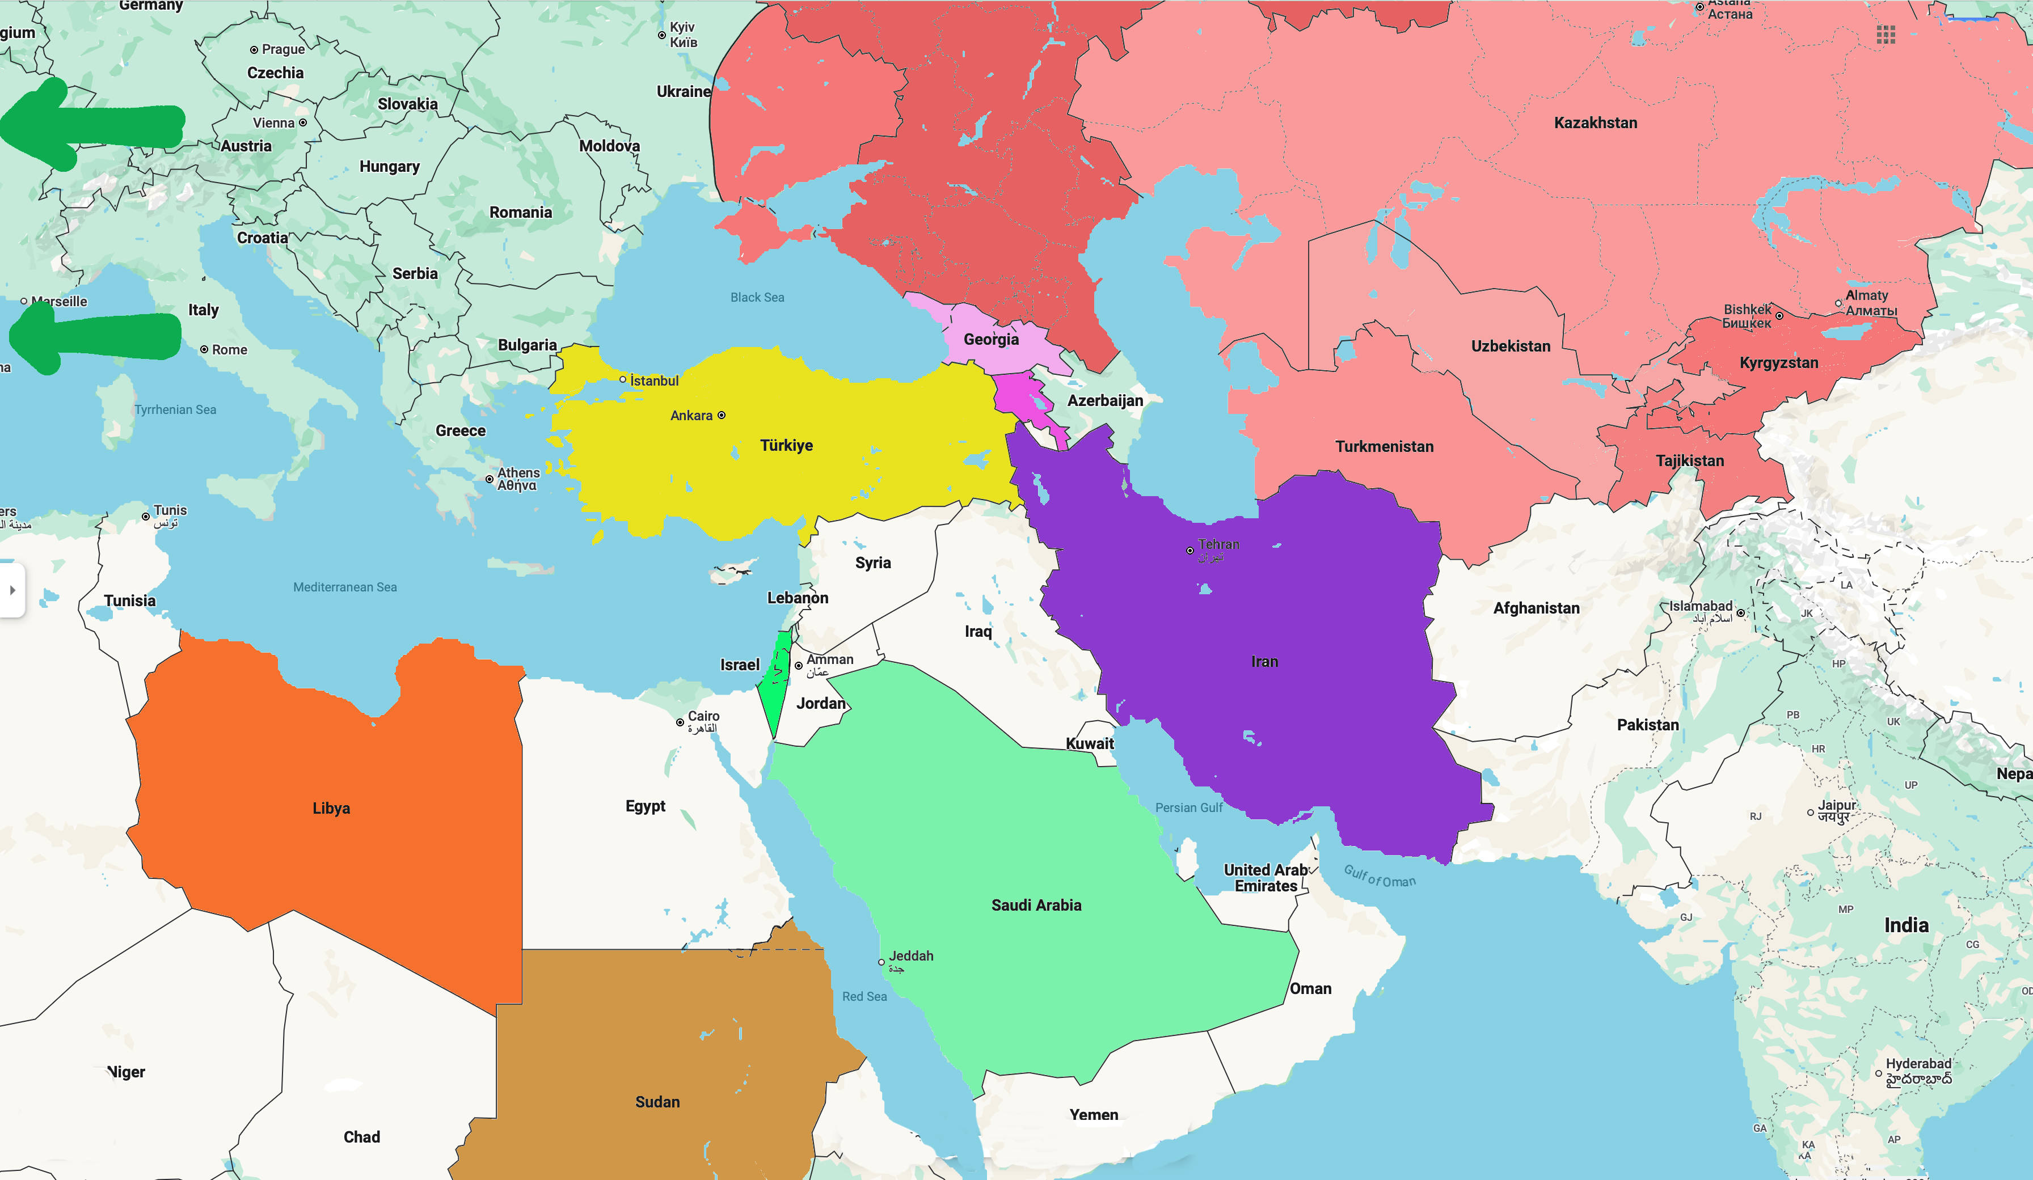
Magog Persia Cush Put Gomer Togarmah Sheba & Dedan Tarshish

